Slide 2
MINOR PROJECT-2
Box’em Up
Under the guidance of
MS. NIHARIKA SINGH
(AS-SS)
UNIVERSITY OF PETROLEUM AND ENERGY STUDIES

Slide 3
INTRODUCTION
Our project aims to develop a real time game using C graphics API OpenGL library glut.
OpenGL (Open Graphics Library) is a cross platform API (Application Programming interface) mainly aimed for rendering 2D and 3d vector graphics
We aim to develop a real time, multi user, multi optional game which has 2 interfaces using basic polygons, lines, points in nested-loops, mouse functions within loops, nested if-else, 1D arrays and 2D arrays as Data Structures for storing grouped data, variables and Booleans for conditional purposes.
Interface 1 asks the user to choose the size of the game and the number of players. Then pressing the start button will start the game and a new Interface will show up with the size of the grid chosen by user.
Interface 2 has a grid with points joined using faded lines. User clicks on the faded lines to highlight the line, and if a line chosen by user completes the square, user is awarded one point and user chooses again. If a user clicks on already selected edge, its an invalid move and user chooses again. This goes on until all the edges of the grid are chosen, and once there are no edge left, a winner is declared with highest number of points.

Slide 4
Literature Review
OpenGL was made to draw everything imaginable on our screens in 2-D as well as 3-D. It helps in creating interfaces, shapes, graphs and animation using very simple to mediocrely complex lines of code.
This game is using very basic OpenGL codes to function on interactive graphical user interfaces. Basic use of matrices and simple computer logic helps the computer to know if a square is completed and it awards a point to the user who completed the said square. Basic mouse clicks functions let the computer know which option was chosen.
For this game, the book OPENGL GAME PROGRAMMING was used and is cited below.
According to the Series Editor, Andre LaMothe, it’s the first book to be totally focused on OpenGL, games and Windows. In this world of Game Development, this game is the first of its kind.
The first of Gaming Books helped in digitalizing one of the most popular game of our childhood.

Slide 5
Objective
Main objective is to develop working interfaces on which multiple users can play a game.
a. Designing and Creating an interface for a user.
Creating a usable interface for the user using OpenGL. Creating the widow and designing using 2D shapes, colours and texts to provide a healthy environment for the user.
b. Taking input as many times as a user clicks on the interface.
The game is based on user clicking to select the edges throughout the game, providing an environment where user can click any number of times is essential part of the game.
C. Processing each input to know which option user chose.
Each click by the user is important for the game to function, backend of the game process each input by user, processing input in order to know what has been selected by the user.
d. Displaying changes on the interface after processing of the input.
Displaying output for each valid input by the user is crucial for the game to move forward. User will know that his response has been accepted, processed and displayed correctly.

Slide 6
METHODOLOGY
This work will be divided into two steps, Interface 1 and Interface 2.
Step 1: Creating the first interface
Interface 1 will be the selection interface for the user with start button where user selects the option and Interface 2 will vary depending upon the option selected in Interface 1. Mouse function, which takes input from user will be called every time the user clicks on the screen, which in turn calls the display function every time it is called.
Once the size and number of players are selected, clicking on start function will open Interface 2.
Interface 1 shows the output to the users (name of game, options etc.), takes input, process input, and showing output according to what has been selected by the user.
Step 2: Creating the second interface
Interface 2 is the actual game area. In this step, all those things done in Interface 1 are repeated with the addition of being displayed on the screen, processing, storing data, and output.
Interface 1 and Interface 2 has same steps but doing different things technically.

Slide 7
METHODOLOGY
Step 3: Implementation
The first interface is implemented using just OpenGL shapes and mouse inputs.
In the actual game, wherever the user clicks, those coordinates will be taken. We will then process these coordinates according to few conditions:
Take the modulus of the input coordinates to get the general location of the mouse pointer.
Check which coordinate is smaller x or y. Based on this we can interpret the line which the user wanted to choose.
Based on the above result we can highlight the line user wants to select.

Slide 8
FLOW CHART
Begin
Window Designing
Take Input
Processing Input
Output and saving information
End

Slide 9
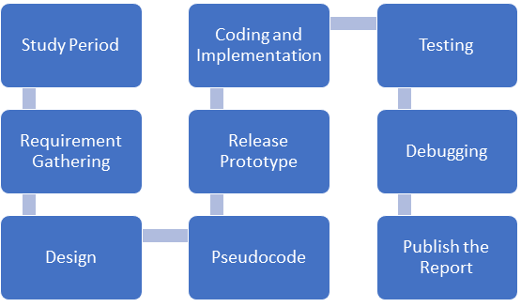
Plan of Work

Slide 10
REFERENCES
1. Mayank Bhardwaj, January 10, 2017. [Online]
Available on - https://www.quora.com/How-is-the-C-Graphics-Library-different-from-OpenGLTop of Form
2. Kevin Hawkins, Dave Astle, “OpenGL Game Programming”, 2001. [Online]
Available on – https://www.google.co.in/books/edition/OpenGL_Game_Programming/XkzkoZi8oQwC?hl=en&gbpv=0

Slide 11
THANK YOU

